Slide 1
Research essay

Slide 2
Overview
What is a research essay?
Research Plan and Annotated Bibliography
Research Essay Assignment
Next steps

Slide 3
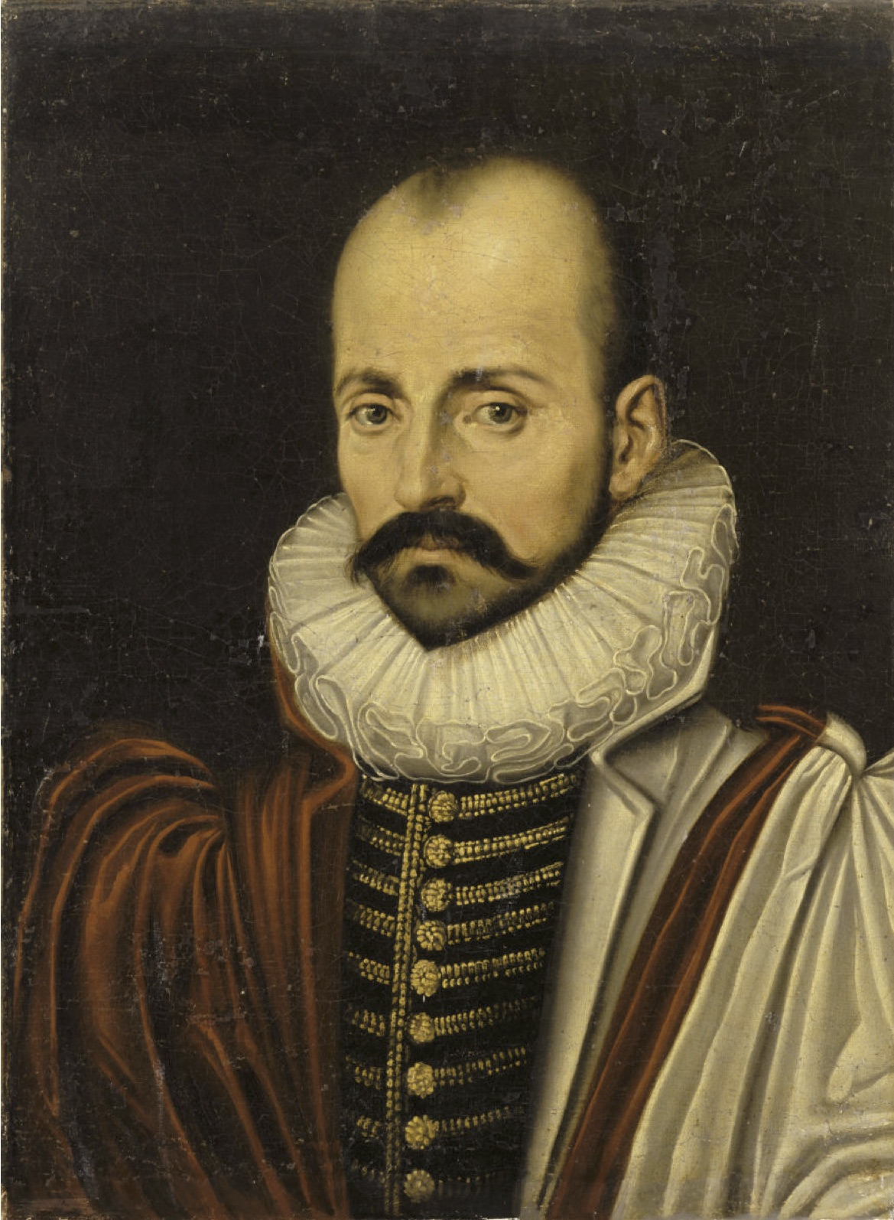
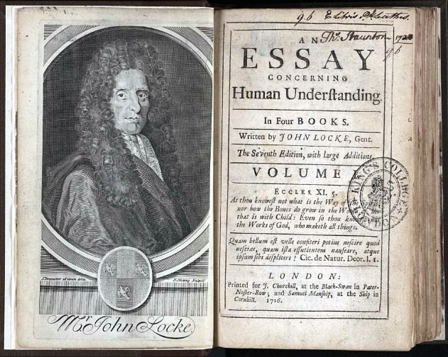
What is a research essay?
Originally a meditation, occasionally personal, on a particular topic, as found in 16th-century inventor Michel de Montaigne’s Essais.
In university, we write to learn about a particular topic.

Slide 4
What is a research essay?
Leads the target audience through an argument supported by evidence in order to reach a conclusion/recommendation/new insight
A research essay does 2 things:
Offers a fair and accurate summary of another author(s)’ work.
Clarifies whether you agree or disagree with the text(s) you are responding to

Slide 5
Overview of the Research Plan and Essay
Research Plan
10%
Proposal and Annotated Bibliography
Due Nov. 20
Research Essay
25%
Peer Review on Dec. 1/2
Final Version due Dec. 6

Slide 6
Research Plan Assignment
2 parts to the Research Plan:
Proposal (1-2 paragraphs/250 words)
Annotated bibliography (3 sources)

Slide 7
What goes into a research proposal?
A formal proposal that describes your topic and focus for the essay. It should include
your research question
provide context
include properly cited evidence
draft thesis statement (if you know it)
Depending on the length of your research paper, a proposal can between 1-20 pages!

Slide 8
What’s an annotated bibliography?
A research document that consists of a list of citations followed by a short summary and evaluation of each source.
Consists of 2 steps:
Proper IEEE citation.
Short paragraph that a) evaluates authority of writer, b) summarizes the article’s content, and c) explains how this text illuminates your research topic.

Slide 9
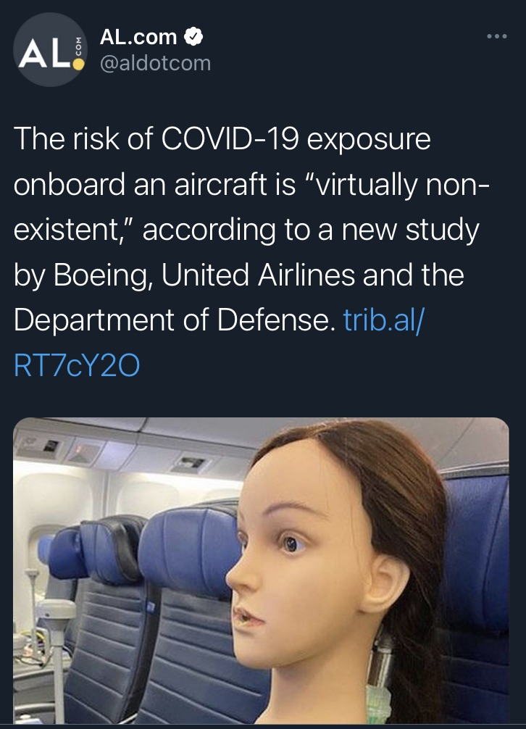
Consider your academic source material carefully, especially you suspect that outside influences have biased the evidence.

Slide 10
Tips for finding articles
Use filters: limit search to pub date, kind of document, full text
Keyword search: accessibility; university campus; disabled students; universal design
Read for speed: start with the intro and conclusion, identify keywords and scan the text for them.
Check out the working bibliography in Module 8!

Slide 11
For further information
Please review both the assignment description and the sample research plan.
WW Chapter 2.8 on annotated bibliographies
WW Chapter 4.5 on undergraduate research
Your research consultations with me will focus on the research plan assignment.

Slide 12
Research Essay Assignment
For your major paper, you will investigate a topic and develop a research question relevant to the course design project.
Remember, you already came up with a potential topic in Module 3. Now it’s time to develop that topic further.

Slide 13
Research Essay Requirements
1200-1500 words (roughly 4-5 pages, not including bibliography)
Formal academic style, using ENGR 110 Style Sheet
Arguable thesis statement on a defined topic, supported with credible evidence
5 credible, relevant, and timely academic sources.
Uses IEEE style correctly and consistently

Slide 14
Research Essay – First steps
Review your research plan: what did you propose?
Categorize your research notes
Use the “path” in your draft thesis to create sections
Create an outline

Slide 15
Not sure where to start? Take another look the “Writing Process” ppt

Slide 16
Other resources to help you
Me!
Working bibliography in Module 8 and Course Reserve in library
Centre for Academic Communication - keep in mind that they are very busy at the end of the semester so book in now!

Slide 17
Recap
Step 1: Research Plan (Proposal and Annotated Bibliography)
Step 2: Research Essay
You’ll need a proper draft by Dec 1/2 for the in-class peer review.

